Slide 1

Organs of government and separation of power
Hasan Muhammad Baniamin

Slide 2
Organs of government
The three main branches/organs of government are
  the legislative,
  executive, and
  judiciary.
The legislative branch makes the laws
The executive enforces the laws, and
The judiciary interprets the laws.

Slide 3
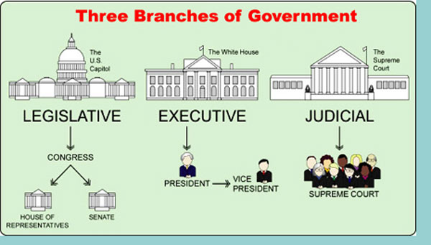
United States

Slide 4


Bangladesh

Slide 5
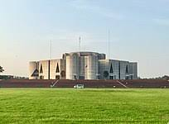
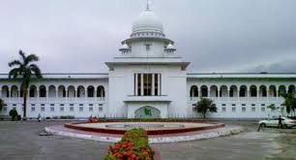
Bangladesh

Slide 6
Separation of power
French Enlightenment political philosopher Baron de Montesquieu best explained the ‘theory of separation of power’ in his book ‘The Spirit of the Laws’ (1748).
He lived at the time of Louis XIV, the author of the famous phrase 'L'etat c'est moi’ (lā-tä se-mwä)('I am the state’)
The monarch combined all the three powers.
Montesquieu visited England in 1726 and impressed by the spirit of freedom prevailing there.
He analysed the freedom, and arrived at the conclusion that the freedom of the people was possible due to the separation of the power among the three branches of the government.

Slide 7
Separation of power
According to Montesquieu, the concentration of the legislative, executive, and judicial functions in one single person or in a body of persons results in the abuse of authority and such an organization is tyrannical. So, they need to be separated.

Slide 8
Criticisms of the separation of power
Absolute separation of power is not possible.
The theory may lead to inefficiency of government.
Authoritarian leaders oppose such separation.
Individual liberty possible even without separation of power.
In USA, this idea is modified as a system of ‘check and balances’.

Slide 9
Criticisms of the separation of power
1. Absolute Separation of Power is not possible:
There is unity in the government as it is in the human body. If all the organs of the government are separated from one another, there will be no mutual cooperation among them. There will be deadlock situation.
2. The basis of theory is confusing:
Montesquieu made the British Constitution as the basis, cause judiciary was independent in Britain and freedom of people was protected. But Montesquieu proved to be wrong, because Britain is a parliamentary government, where executive (council of ministers) is under the parliament.

Slide 10
Criticisms of the separation of power
3. The Organ of Government are not co-ordinate:
The theory recognized three organs are equal - this is wrong because the important of legislature has increased due to democracy.
Laski says, “Legislature could not fulfill their task unless they were able to both interfere in the execution of law and also on occasions, to overrule statute, the decision of the judges the result of which are widely felt to be unsatisfactory”
4. The theory will lead to inefficiency if it implement in its complete form
“If the principle of separation of power is applied in its complete form, disintegrating the realities, government machinery will come to a standstill” ( Dr Finer)

Slide 11
Criticisms of the separation of power
5. Individual Liberty possible even without separation of powers
Montesquieu was of the view that without separation of powers, individual freedom was not possible. But this is not true. In the times of Montesquieu, there no separation of powers in England., but people enjoyed freedom. Because judiciary was free in that country and rule of law prevailed.
In countries like Japan, France, Italy, Germany and some other democratic countries, though there is no separation of power, yet the people enjoyed freedom. This is so because the people have been given fundamental rights through the constitution and judiciary is independent.
6. The theory may not be practical, even in U.S.A. it has been modified by a system of checks and balance

Slide 12
US Check and Balance
Three organs function independently in USA; but the President has been given a the veto power. The Congress can remove that veto by a 2/3rd majority.
The President has been given power to sign treaties and to make political appointment but they have to be ratified by the Senate.
The Congress can remove the President though impeachment.
The President can send messages to the Congress and , if need arises, he can call a special session of the Congress.
The judges of the Supreme Court are appointed by the President, but they can be removed by the Congress though impeachment.
The Supreme Court can declare the law made by the Congress illegal if they violate the Constitution.

Slide 13
Suggested readings
Agarwal, R. C. (2014). Political Theory: Principles of Political Science (New Delhi: S. Chand and Company Limited). (Chapter 26).

Slide 14
Q?

